Slide 1
DONATION WEBSITE USING JSP SERVLETS
Group Members:
Ganesh Chaudhari (14)
Rohan Jadhav (26)
Sanket Jadhav (28)

Slide 2
Content
INTRODUCTION
Literature Survey
Motivation
Objective
Proposed work with Methodology
Software & Hardware Platform

Slide 3
INTRODUCTION
Our country has seen tremendous economic advancement over the past two decades.
NGOs run massive awareness, sensitization and development programmers to end the factors that trigger poverty.
Thus with this project we mainly focuses on donation related basic operations like adding new NGO entries , updating NGO details and donating necessary items like food, clothes, money and medicine; in order to execute on-ground initiatives to empower communities.

Slide 4
Literature survey
SR NO. | TITLE OF PAPER | AUTHOR | METHODOLOGY
1. | DONORS AND SEEKERS: AN ONLINE PLATFORM FOR DONATION | Manoj M. mewani, Chandra kant V. Jalke, | The project that will allow a smooth and easy donation distribution. The paper explains the concept of donation distribution and controlling.
2. | Charity Connecting System | M. Archana, K. Mouthami | NGO receives donation from the donor and receipt message will be sent to the donor. Amount which is given by the donor will be sent to the NGO account.

Slide 5
Motivation
In Present many people give things or money to charity, and many of them make regular donations whether its money, clothes or other items.
Also, many organizations offer a door to door collection service for donations and sometimes there is nothing to collect.
The goal of the planned Website is to give to the needed NGO's so their staff will collect goods from users.
It will help NGO's as well as public who wanted to make donation.

Slide 6
Objective
Develop a system that provides a convenient way for a user to donate things or money for charity purposes.
Develop a database which stores user details and donations details.

Slide 7
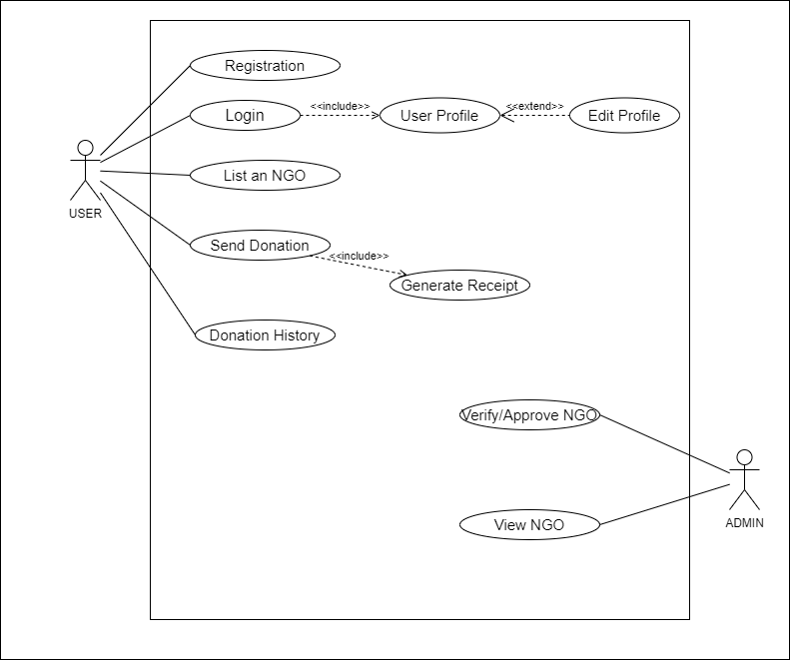
System Architecture
Use case Diagram

Slide 8
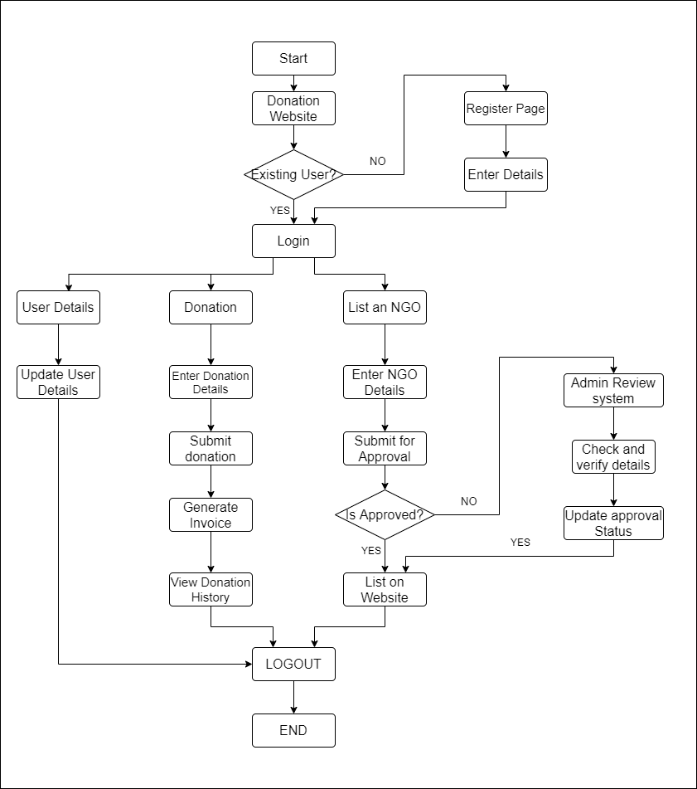
  Flow Diagram

Slide 9
Proposed Work With Methodology
Earlier many people donate to charity, and many of them make regular donations whether its money, clothes or other items.
Also, many charity organizations provide a door to door collection service for donations and sometimes there is nothing to collect; The aim of this project is to build a Website that helps charities (large or small) to gain more donations, and to reduce door to door collections.

Slide 10
Software and Hardware Platform
Software Requirement :
o In the project the software requirements are as follows:
➢ Language for Development : JAVA
➢ Database : MySql
➢ Browser : Google chrome or Mozilla
• Hardware requirements:
o In the project the hardware requirements are as follows:
➢ Minimum RAM : 1 GB
➢ Hard Disk : 40 GB
➢ Processor: Intel Pentium 4 (Minimum) /AMD Processor
➢ Operating System: All operating systems.

